Slide 1
README for Project 2-2
GAN and VAE
AI ToolKit
Fall Semester, 2023

Slide 2
Task: Fashion-MNIST generation
To Do: Write codes to train two generative models for Fashion-MNIST dataset!
You need to write codes for DCGAN and VAE
You need to complete the given tasks, and write a report based on results.
In your report, do not forget to add discussion about your result.

Slide 3
Dataset: Fashion MNIST

Slide 4
How to load Fashion MNIST dataset
Load Fashion MNIST Dataset with torchvision.datasets
import torchvision.datasets as dsets
Then, make a train dataset by setting the parameter train to True
train_dataset = dsets.FashionMNIST(train = True)
train_loader = DataLoader(train_dataset, shuffle = True)
Fix the image size to 28 x 28
You can use any image transformation as below example transform_train = transforms.Compose( [transforms.ToTensor(), transforms.Resize((image_size, image_size)), transforms.Normalize(mean, std)])

Slide 5
TASK 1
Deep Convolutional Generative Adversarial Networks (DCGAN)

Slide 6
DCGAN https://tutorials.pytorch.kr/beginner/dcgan_faces_tutorial.html
Model
Build DCGAN Generator and Discriminator
You should follow DCGAN Architecture
Do not use only linear layers to build generator and discriminator
Use deconvolution and convolution layers to build these networks
Training
Noise sampling
Noise should be sampled from standard normal distribution noise = torch.randn(batch_size, nz) # fix nz = 100
Fix the size of noise vector to 100 (nz = 100)
Other parameters can be adjusted appropriately
batch size, learning rate, …
Save weights of trained Generator models for several epochs to generate fake images.

Slide 7
TASK 1-1
Print your models (15 points) print(model)
In your report, add the result after printing your Generator and Discriminator
Only command line screenshot is allowed (no text format)
Refer to the DCGAN Architecture and use Batch Normalization and LeakyReLU activation function
----------------------------------------------------------------
Layer (type) Output Shape Param #
================================================================
Linear-1 [-1, 12544] 1,254,400
BatchNorm1d-2 [-1, 12544] 25,088
ReLU-3 [-1, 12544] 0
ConvTranspose2d-4 [-1, 128, 14, 14] 524,288
BatchNorm2d-5 [-1, 128, 14, 14] 256
ReLU-6 [-1, 128, 14, 14] 0
ConvTranspose2d-7 [-1, 64, 28, 28] 131,072
BatchNorm2d-8 [-1, 64, 28, 28] 128
ReLU-9 [-1, 64, 28, 28] 0
Conv2d-10 [-1, 1, 28, 28] 577
Tanh-11 [-1, 1, 28, 28] 0
================================================================

Slide 8
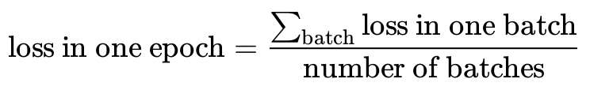
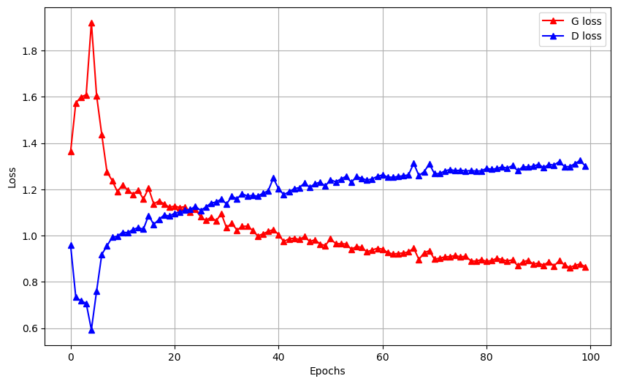
TASK 1-2
Show learning curves of Generator and Discriminator over epochs (15 points)
In your report, you should plot a graph (or graphs) showing the training loss of Generator and Discriminator over epochs
Here, the training loss in one epoch can be defined by
Use large number of epochs (i.e., 100)
Example:

Slide 9
TASK 1-3
Generate samples with trained Generator (20 points)
Sample several random noise vectors
number of vectors = 12
Select at least 5 epochs (for example, [1, 5, 10, 50,100]) based on the learning curves.
Which means, you need to select at least 5 different Generators from certain epochs.
Give the sampled random noise vectors as inputs to selected Generators, and plot generated data samples
By doing so, one can observe the changes of generated samples over selected Generators in different epochs.
Generated samples should be arranged in 3x4 grid

Slide 10
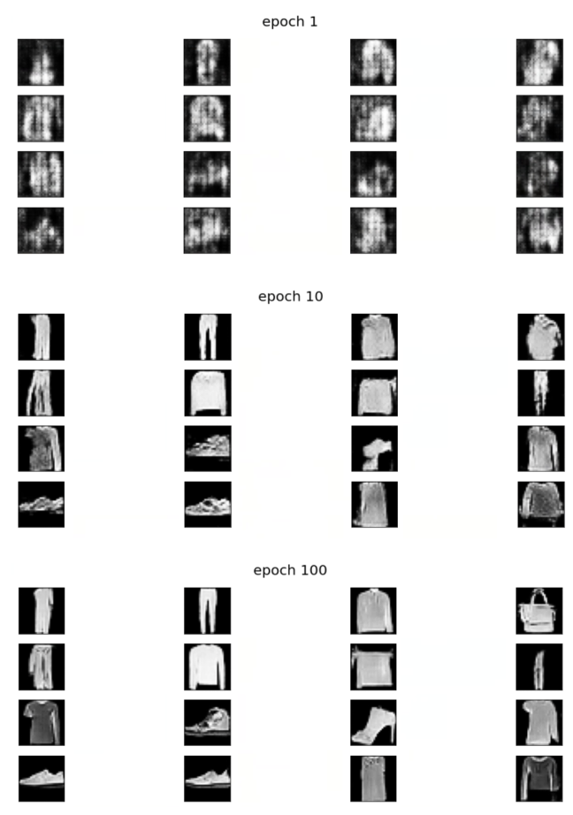
TASK 1-3
A result of generated samples with
3 different Generators
(epoch : 1, 10, 100)

Slide 11
TASK 2
Variational Autoencoders

Slide 12
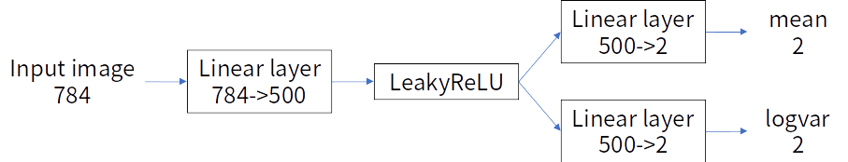
Variational Autoencoder (VAE)
Model
Build MLP-based VAE (convolution is not allowed)
Input image: 784(=28x28) length vector
Encoder:
Latent dimension: 2
Decoder:

Slide 13
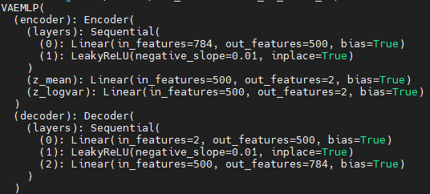
Variational Autoencoder (VAE)
Model
Resulted model composition should be look like below, when using print(model):

Slide 14
TASK 2-1
Print your models (10 points) print(model)
In your report, add the result after printing your whole VAE model
Only command line screenshot is allowed (no text format)
Please refer to previous slide
If below conditions are satisfied, you will get max point:
Same number and order of linear and leakyReLU layers
Same input/output size
No other unspecified layers(e.g. Conv or ReLU)

Slide 15
TASK 2-2
Report training loss trend over epochs (10 points)
You can use any logging/visualization tool(e.g. tensorboard, wandb, or matplotlib)
You should report the number of training epochs
If below conditions are satisfied, you will get max point
MSE loss and KL loss are separately logged
Losses are logged per epoch (not iteration)
Losses reasonably converge during training

Slide 16
TASK 2-3
Report generated samples along the training epochs (10 points)
Generate samples with fixed noise across epochs
Generated samples should have similar context across epochs
You should make 3x4 grid of images at each epoch
You should make 3x4 grid image 5 times at different epochs
e.g. make 3x4 grid image at 10, 20, 30, 40, 50 epoch

Slide 17
TASK 2-4
Train and evaluate a MLP classifier on Fashion-MNIST (10 points)
MLP classifier should be the same as VAE encoder except the last layer
Report your model composition using ‘print(model)’
Report test set accuracy using this model
Use the FashionMNIST train/test dataset with torchvision’s dataset class.
If below conditions are satisfied, you will get max point
Classifier model composition is the same as the instruction
Test set accuracy is reasonably high (>80%).

Slide 18
TASK 2-5
Initialize VAE’s encoder weights using the classifier weights trained at Task 2-4 (10 points)
Encoder’s first linear layer should be initialized with classifier’s first linear layer
Report the result and compare with the vanilla VAE
Report loss trend and the generated samples across epochs (same as Task 2-2, 2-3)

Slide 19
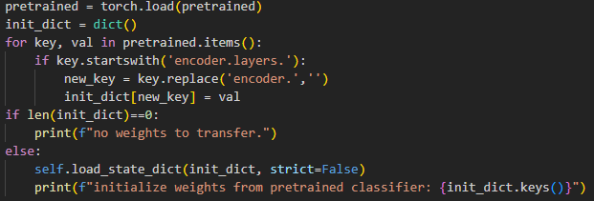
TASK 2-5
How to initialize encoder weight using the classifier weights?
Load classifier weights first.
Get classifier’s first linear layer by searching key string.
Make a new dictionary with the keys compatible with VAE.
Initialize VAE model weights with the new dictionary.

Slide 20
What should be submitted?
Submit a report named [student id]_[first name]_[last name].pdf
For instance, my report would be 202212345_Hyemin_Ahn.pdf
Please make your report with this name format.
Your report needs be around 4-5 pages in double columns.
You can write a report with Word or Latex.
Submit PDF file, not .doc or .tex file!

Slide 21
Deadline and where to submit?
Deadline: 23:59, 17th December
Submit it to…
Assignment tab in Blackboard System

Slide 22
Any Questions?

